Slide 1

Flight Price Prediction Project

Slide 2
Airline companies use complex algorithms to calculate flight prices given various conditions present at that particular time. These methods take financial, marketing, and various social factors into account to predict flight prices.
Nowadays, the number of people using flights has increased significantly. It is difficult for airlines to maintain prices since prices change dynamically due to different conditions. That’s why we will try to use machine learning to solve this problem. This can help airlines by predicting what prices they can maintain. It can also help customers to predict future flight prices and plan their journey accordingly.
INTRODUCTION

Slide 3
Hardware and Software Requirements and Tools Used
RAM: 8GB
ROM: I3 processor
SOFTWARE: Python 3.9.6
LIBRARIES: Numpy, Pandas, Seaborn, Sklearn, Scipy .
Tools: Jupiter notebook, Matplotlib, Scikit-learn, Excel.
Testing of Identified Approaches (Algorithms)
K-Neighbors Regressor
Decision Tree Regressor
Random Forest Regressor
Ridge
Lasso
Logistic Regressor

Slide 4
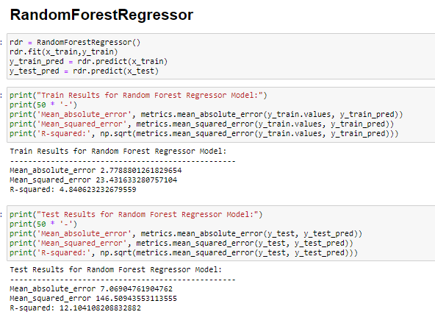
Run and Evaluate selected models
MODELS

Slide 5
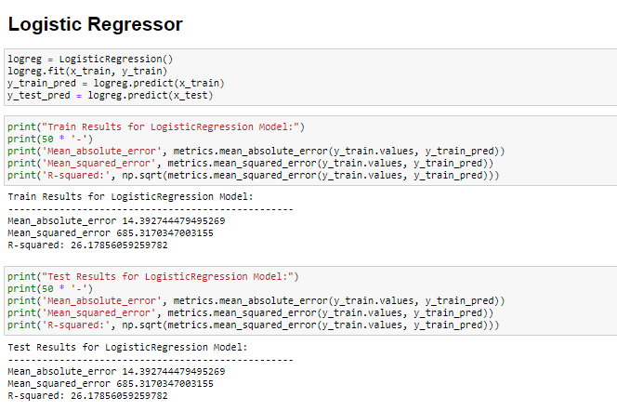

Slide 6
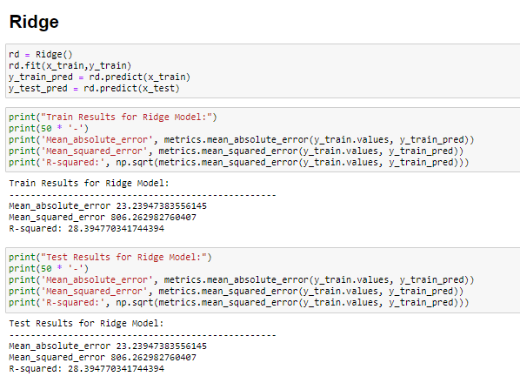

Slide 7
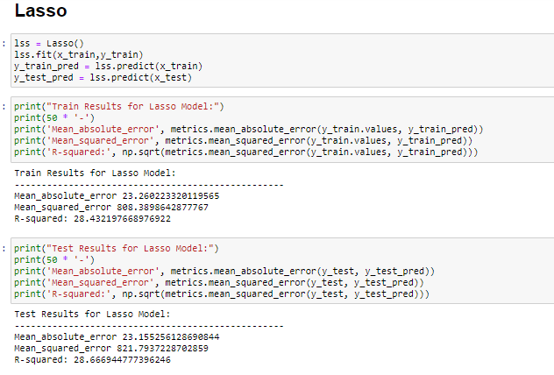

Slide 8
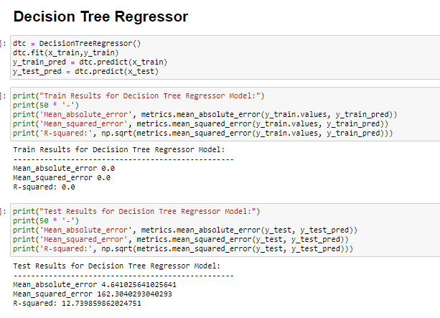

Slide 9
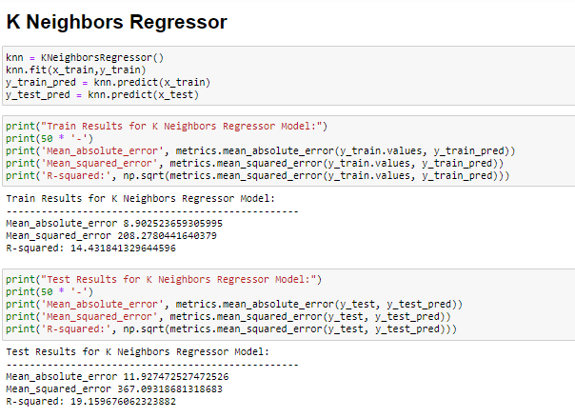

Slide 10
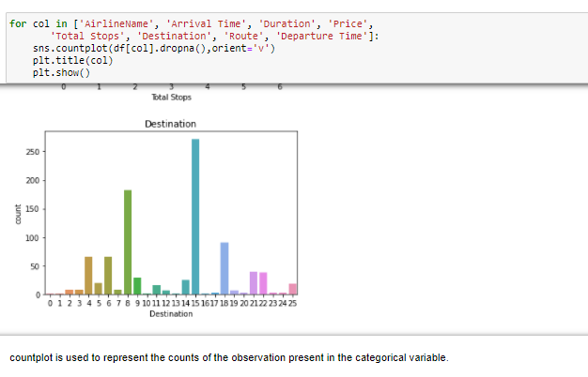
Visualizations
Count plot
Boxplot
Distplot
Scatterplot
Heatmap
Countplot

Slide 11
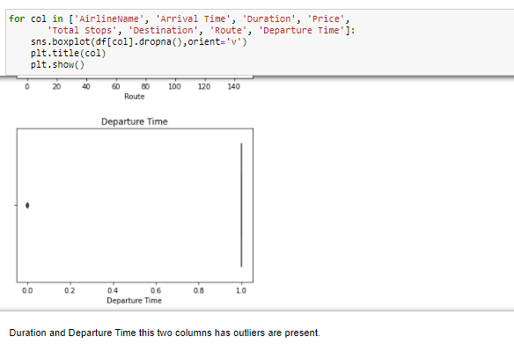
2) Boxplot

Slide 12
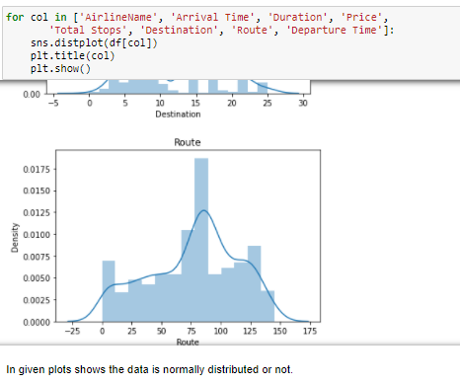
3) Distplot

Slide 13
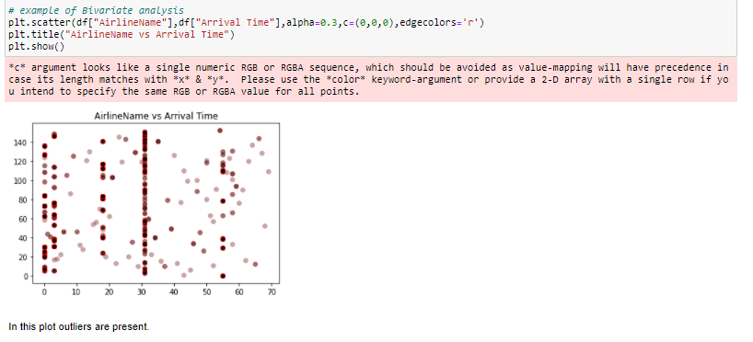
4) Scatterplot

Slide 14
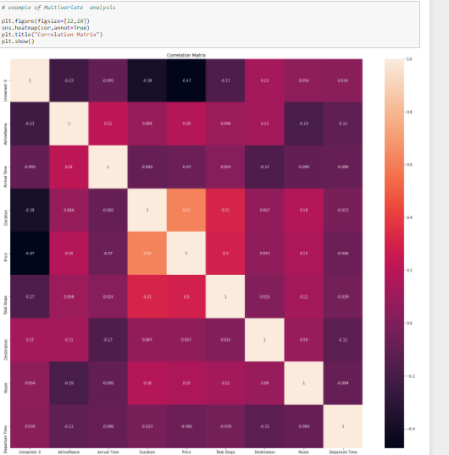
5) Heatmap

Slide 15
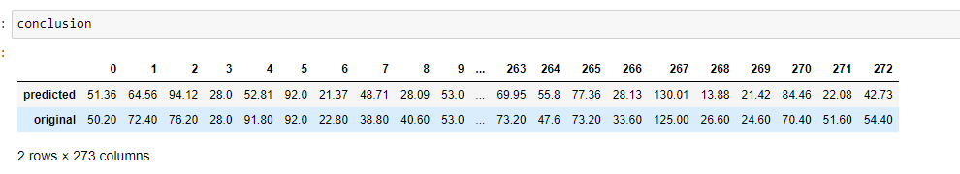
CONCLUSION
In these project, Decision Tree Regressor, Random Forest Regressor, K-Neighbors Regressor, Ridge, Lasso these models are used.
Random Forest Regressor is r2 score ,Mean absolute error, Mean_squared_error and R-squared is good than other models, Hence Decision Tree Regressor is performing is good.
Random Forest Regressor is best model for this dataset.

Slide 16
THANK YOU

